Slide 1
How to Build an Industry Cost Profile (ICP) for a service in the U.S.A.
Select the Industry Code Based on the Supplier’s Business and Product
Step 3
Use Financial Data to Calculate Ratios for COS, PBT, GSA & Other Expenses
Step 4
Use Services Data to Calculate Ratios for DL and SOH
Step 1
Step 2
Identify Data Sources for Financial and Services Information Related to Industry Code

Slide 2
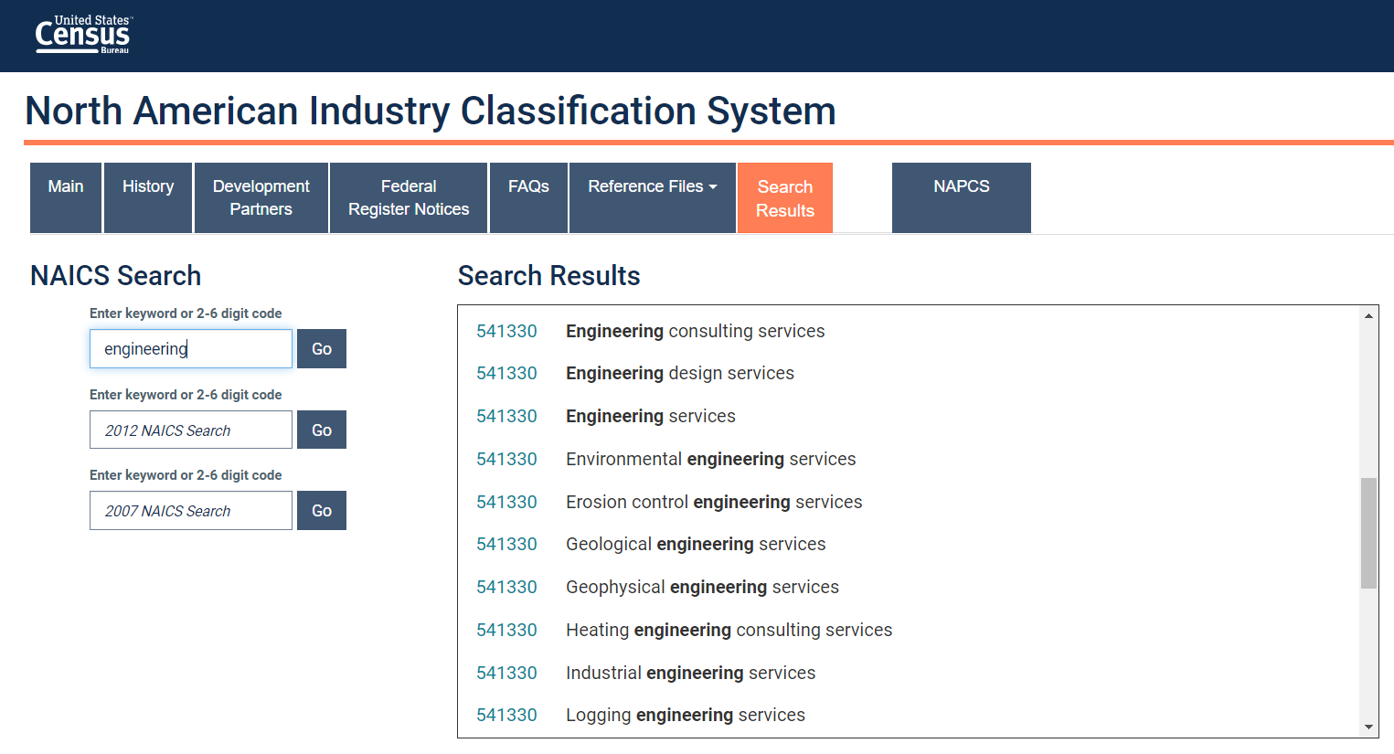
Select the Industry Code Based on the Supplier’s Business and Services
Step 1
Go to:
Conduct a word search to find possible NAICS codes for the product
Select the NAICS code with the best match and record for later use
https://www.census.gov/naics/
Tip: click on the code to view its full definition

Slide 3
Identify Data Sources for Financial and Manufacturing Information Related to Industry Code
Step 2
U.S. Government economic statistics are found at:
Financial data of companies can be found at:
 | Direct Labor (DL)
 | Service Overhead (SOH)
 | Cost of Sales (COS)
 | GSA & Other Expenses
 | Profit Before Tax (PBT)
 | Total Sales
Services data
Source: U.S. Government economic statistics
census.gov
Financial data
Source: Financial reports of companies
sec.gov/edgar.shtml
*You will use these data sources to express DL, SOH, COS, GSA & Other Expenses and PBT as ratios, in the form of percentages of Total Sales.

Slide 4
Use Financial Data to Calculate Ratios for COGS, PBT, GSA & Other
Step 3
From each firms’ Income Statement, use multiple year averages to calculate COS, GSA & Other Expenses and PBT.
Use as many firms as you judge necessary to get an accurate representation of the industry you are modelling.
Alkan Technologies (AT)*
 |  | 2020 | 2019 | 2018 | Average
 | COS | 87.7% | 88.6% | 89.1% | 88.5%
 | GSA & Other | 7.7% | 7.4% | 7.1% | 7.4%
 | PBT | 4.6% | 4.0% | 3.8% | 4.1%
 | Total Sales | 100% | 100% | 100% | 100%
*Example firm operating in the Engineering Services Industry
$$COS \%=\frac{COS}{Total Sales}$$
$$PBT \%=\frac{PBT}{Total Sales}$$
GSA & O. Exp. % = Total sales (100%) – COS % – PBT %

Slide 5
Use Financial Data to Calculate Ratios for COGS, PBT, GSA & Other
Step 3
Average the ratios of the selected firms to create your industry ratios.
Selected firms in Engineering Services industry*
 |  | Firm 1 | Firm 2 | … | Firm 7 | Average
 | COS | 88.5% | 90.1% | … | 89.4% | 88.7%
 | GSA & Other | 7.4% | 7.2% | … | 6.4% | 7.3%
 | PBT | 4.1% | 2.7% | … | 4.2% | 4.0%
 | Total Sales | 100% | 100% | … | 100% | 100%
*Example data for illustration purposes only

Slide 6
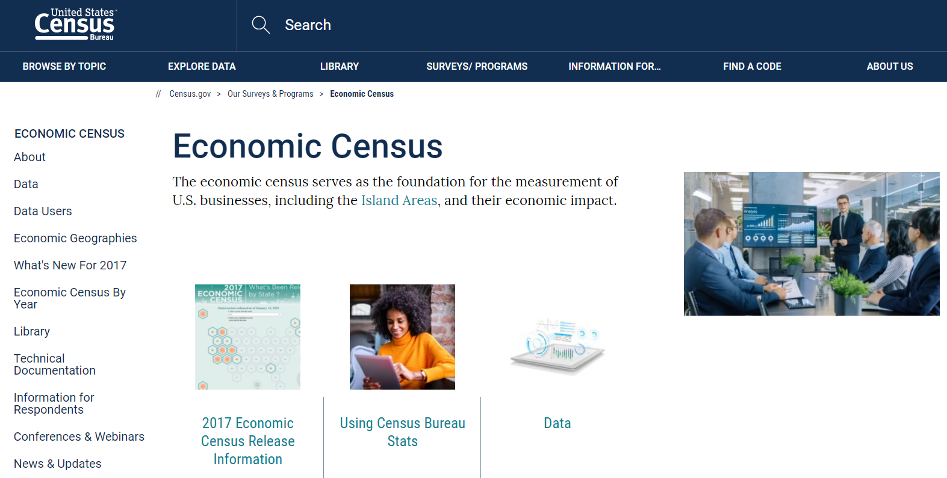
Obtain the latest available Economic Census data from the US Bureau of Census for the industry of interest
Step 3
Go to:
Select SURVEYS and click on Economic Census
Select Data
www.census.gov

Slide 7
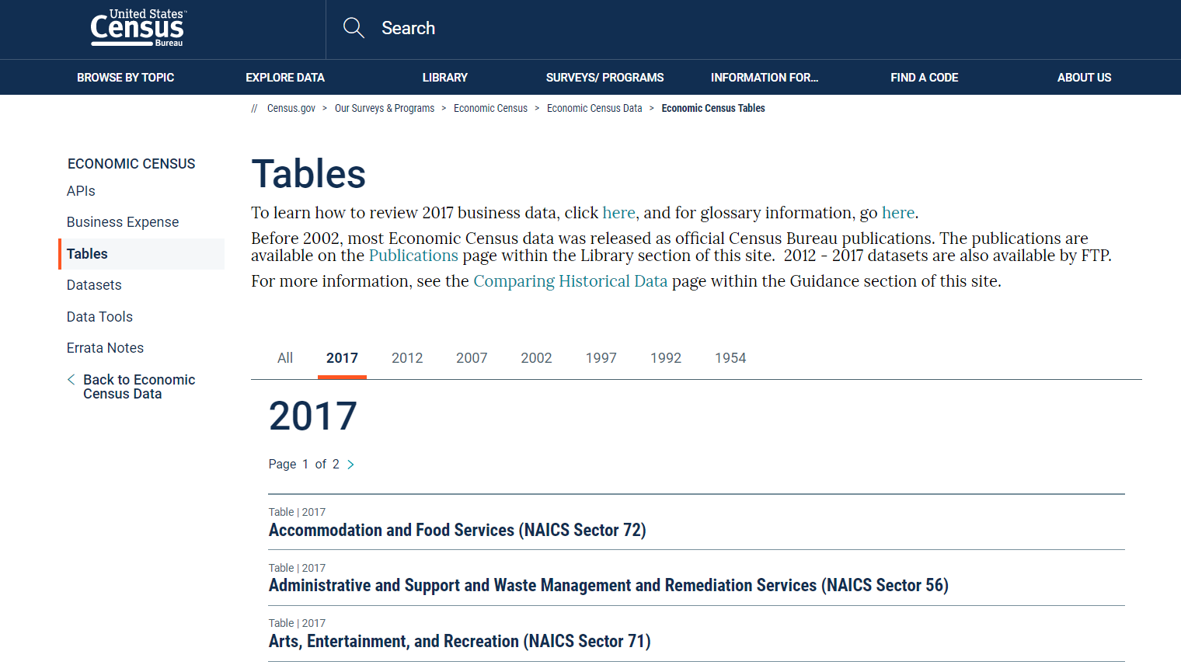
Obtain the latest available Economic Census data from the US Bureau of Census for the industry of interest
Step 3
Scroll down till you find table titled “Professional, Scientific, and Technical Services (NAICS Sector 54)
Select the table

Slide 8
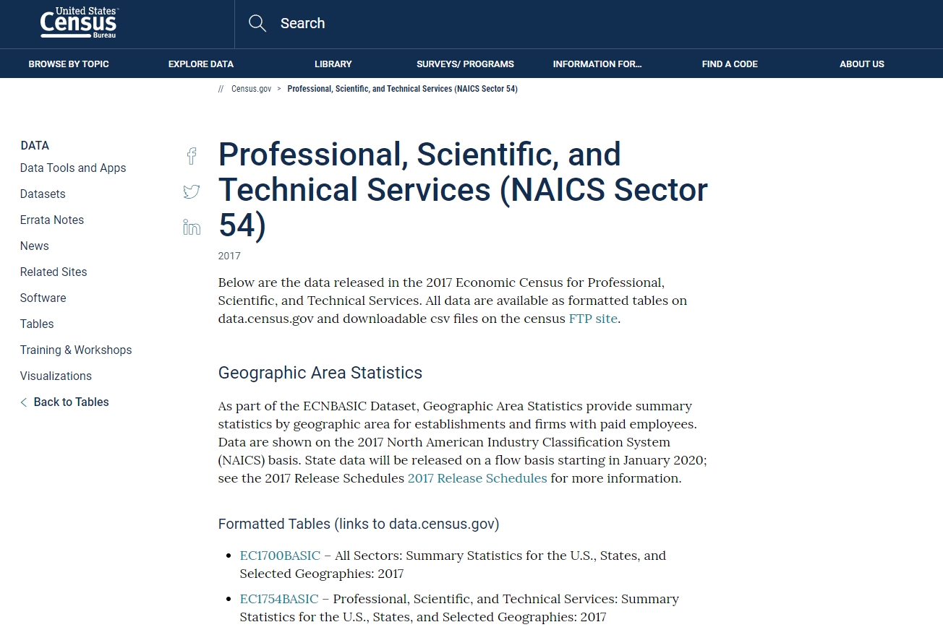
Obtain the latest available Economic Census data from the US Bureau of Census for the industry of interest
Step 3
Select the table titled “EC1754BASIC- Professional, Scientific, and Technical Services: Summary Statistics for the US, States and Selected Geographies: 2017”

Slide 9
Obtain the latest available Economic Census data from the US Bureau of Census for the industry of interest
Step 3
Click on “Geos” and select “Nation”
Ensure that ONLY “United States” is visible under “Selected Geographies”
Unselect any other filter if present
Click on “Close”

Slide 10
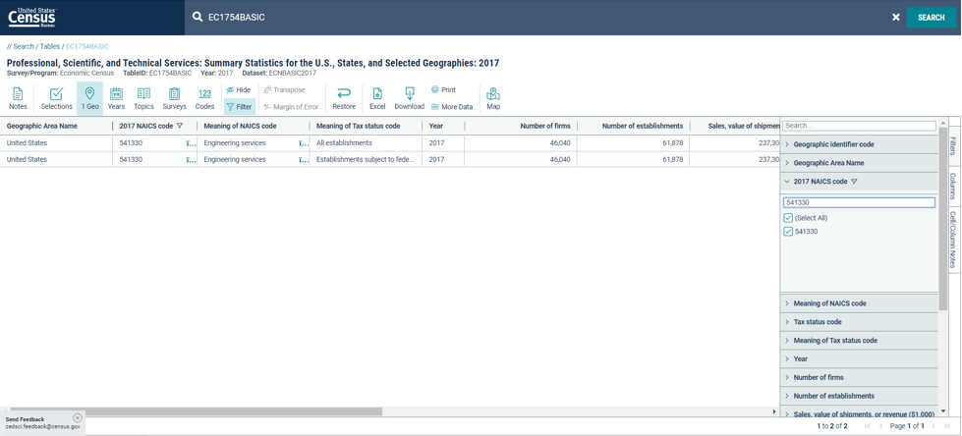
Obtain the latest available Economic Census data from the US Bureau of Census for the industry of interest
Step 3
Click on “Filter”
Click on “2017 NAICS code”
Type the industry code “541330” into the search bar
Select the industry of interest and click enter on your keyboard

Slide 11
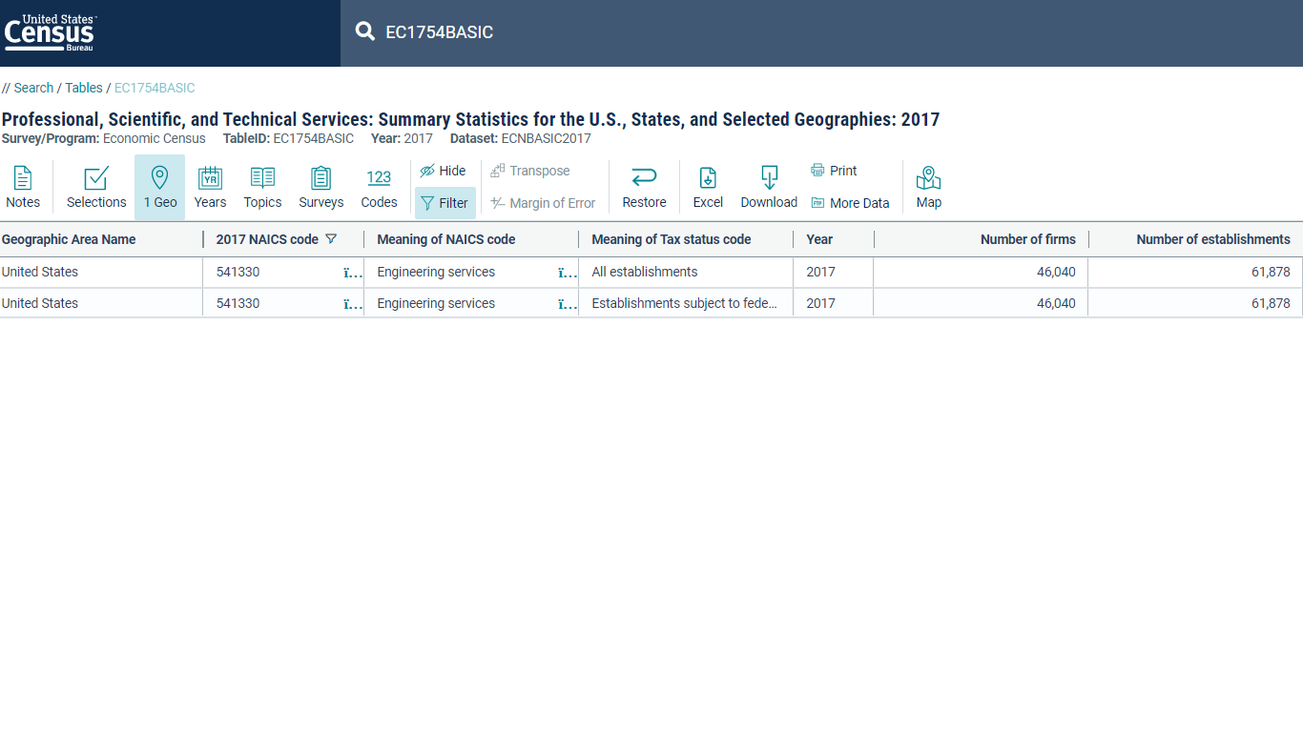
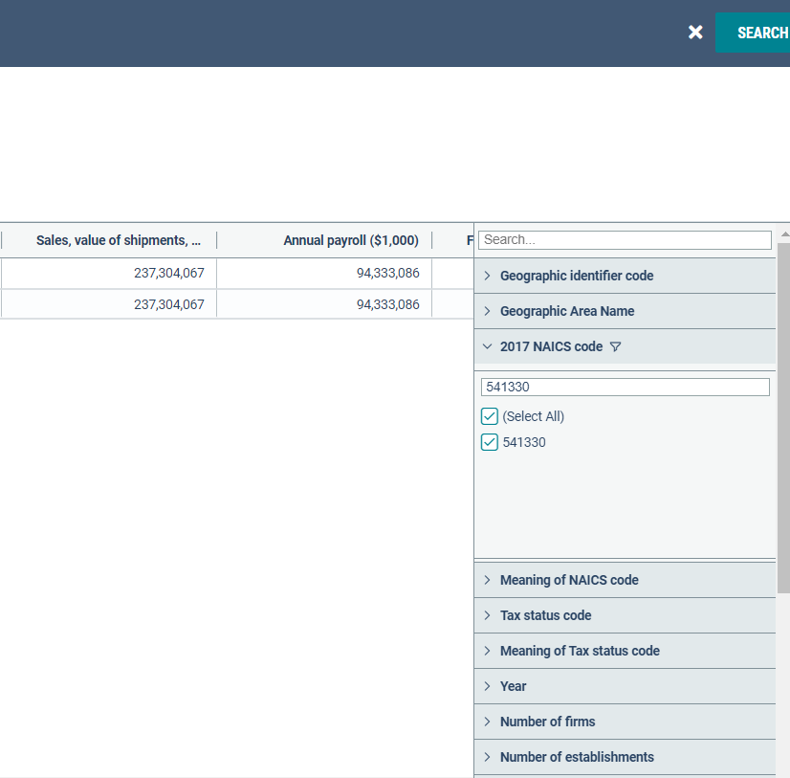
Obtain the latest available Economic Census data from the US Bureau of Census for the industry of interest
Step 3
Scroll to the right and note down values for the following:
1) “Sales, value of shipments, Revenue ($1,000)”
2) “Annual payroll ($1,000)”

Slide 12
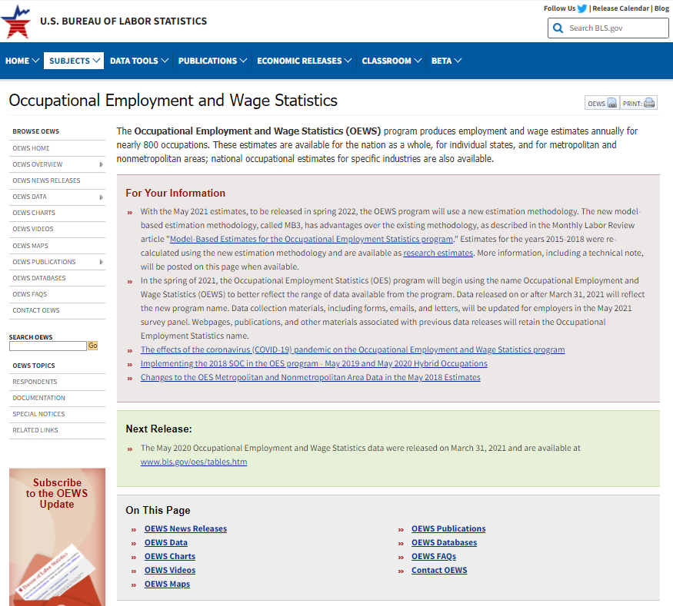
Download industry wage data from the U.S. Bureau of Labor Statistics
Step 4
1. Go to:
And click on ‘OEWS Databases’
2. Click on ‘One-screen data search’
https://www.bls.gov/oes/

Slide 13
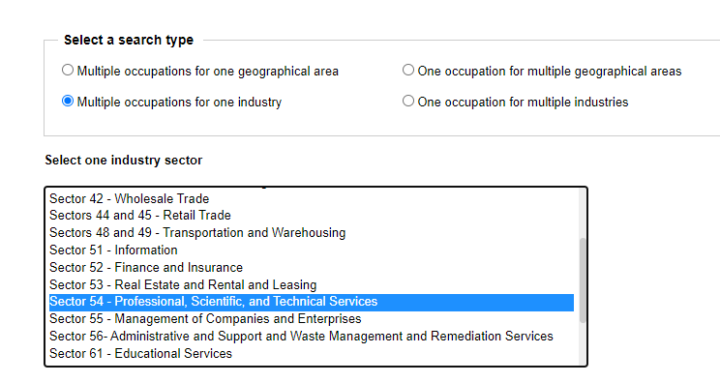
Download industry wage data from the U.S. Bureau of Labor Statistics
Step 4
3. Select ‘Multiple occupations for one industry’
4. Find the appropriate industry sector for the NAICS code you are looking up

Slide 14
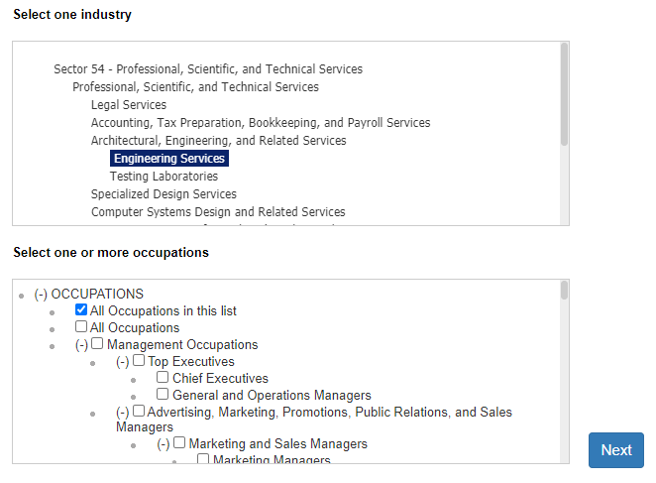
Download industry wage data from the U.S. Bureau of Labor Statistics
Step 4
5. Highlight the industry NAICS code of interest
6. Select ‘All occupations in this list’

Slide 15
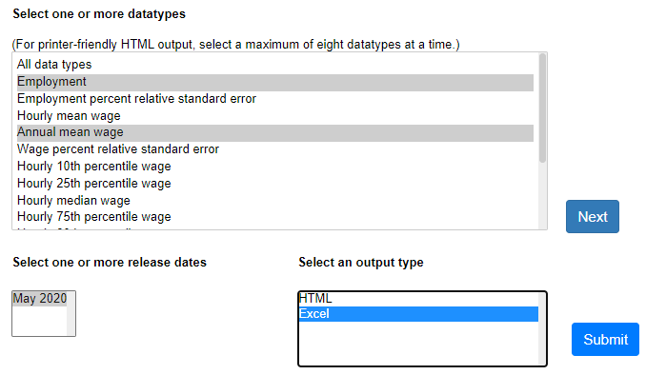
Download industry wage data from the U.S. Bureau of Labor Statistics
Step 4
7. Highlight both ‘Employment’ and ‘Annual mean wage’
8. Select the most recent release date and ‘EXCEL’ as the output type
When you click ‘continue’ an excel file will download

Slide 16
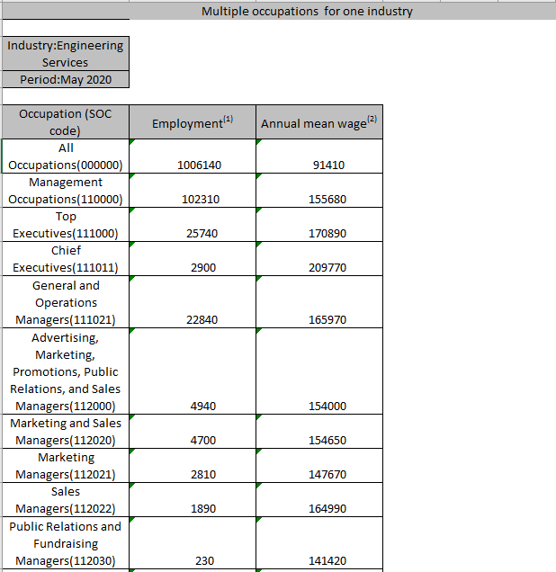
Select which occupations are Direct Labor
Step 4
1. Open the downloaded excel file

Slide 17
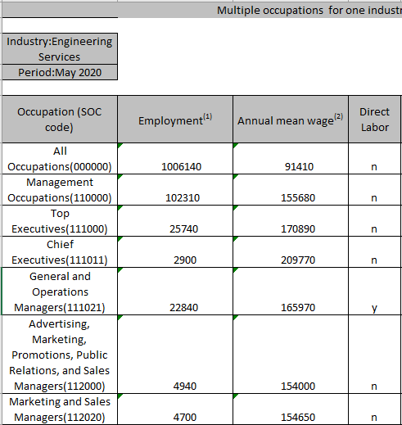
Select which occupations are Direct Labor
Step 4
2. Label Column D ‘Direct Labor’
3. Label which occupations are Direct Labor
Label the direct labor occupations (y/n)

Slide 18
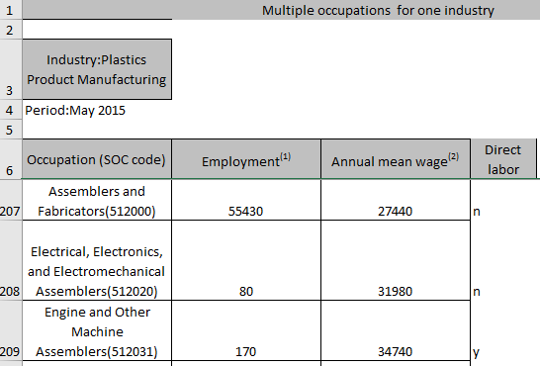
Select which occupations are Direct Labor
Step 4
4. Do not label any occupation that has a SOC code that ends in “O” as Direct Labor, as these are higher-level groupings that contains multiple occupations. If you label and include them you will end up double counting the numbers.
SOC codes

Slide 19
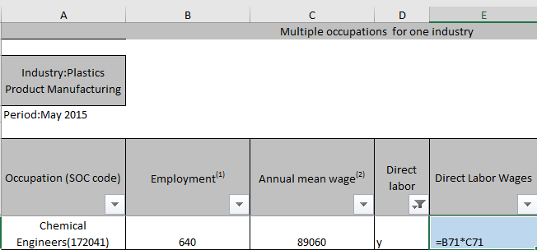
Calculate the Direct to Total Labor ratio for the industry
Step 4
1. Label Column E ‘Direct Labor Wages’
2. Multiply the values of column B and column C for all occupations that you labelled as ‘Direct Labor’, this gives you the total wages for that occupation

Slide 20
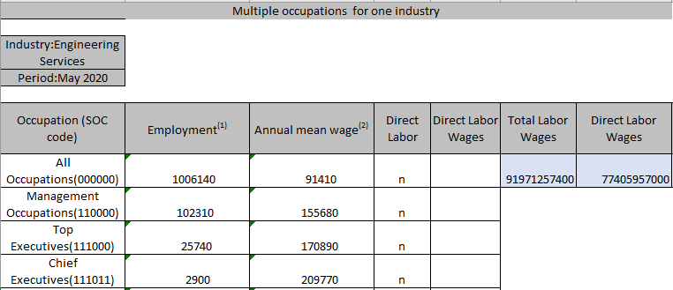
Calculate the Direct to Total Labor ratio for the industry
Step 4
3. Label Column F ‘Total labor wages’ and calculate by multiplying values of column B and column C for ‘All Occupations (000000)’ in row 7
4. Label Column G ‘Direct labor Wages’ where you calculate the sum of column E

Slide 21
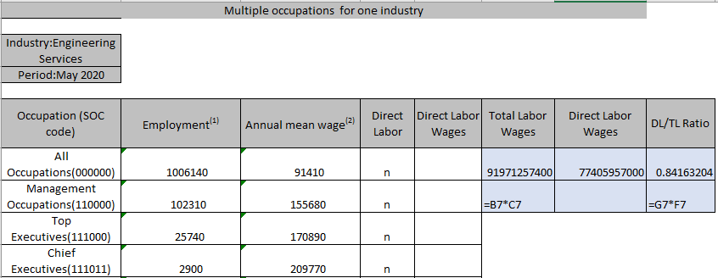
Calculate the Direct to Total Labor ratio for the industry
Step 4
5. Label Column H ‘Direct Labor to Total Labor Ratio’ and calculate by dividing ‘Direct Labor Wages’ by ‘Total wages’ (Column G4 / Column F4).

Slide 22
Use Manufacturing Data to Calculate Ratios for DM, DL, and MOH
Step 4
Calculate the DL value by multiplying the Annual Payroll by DL/TL Ratio
Calculate DL Ratio by dividing DL by Total value of sales and shipments
Calculate the Service Overhead as follows:
 | Annual Payroll ($’000) | 94,333,086
 | DL/TL Ratio | 0.842
 | Direct Labor (Absolute Value) | 79,428,458
 | Direct Labor | 79,428,458
 | Total value of sales and shipments | 237,304,067
 | Direct Labor (DL) | 33.5%
 | Cost of Sales | 88.7
 | Direct Labor | 33.5
 | Service Overhead (SOH) | 55.2%
X
÷
-
SOH = COS - DL

Slide 23
Present all your calculated ratios in the cost breakdown format
Industry cost profile for “Engineering Services”
 | Direct Labor (DL) | 33.5%
 | Service Overhead (SOH) | 55.2%
 | Cost of Sales (COS) | 88.7%
 | GSA & Other Expenses | 7.3%
 | Profit Before Tax (PBT) | 4.0%
 | Total Sales | 100.0%
Ratios calculated from U.S. government economic statistics
Ratios calculated from companies’ financial data

